Slide 1
SOLR Synonyms + Stemming

Slide 2
Step 1: Synonyms + Stemming for Single terms
Example: Category of synonyms for the word ‘jump’
Synonyms file contains the 3 keywords” jump, hop, leap; also contains noun forms of word ending in ‘er’
Stemming misses these cases of ‘er’ conjugation of verb, but catches pluralizations of these words

Slide 3
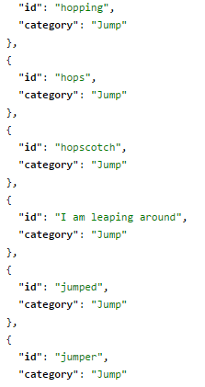
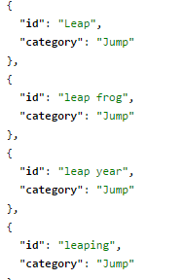
Finding all possible matches
When running SOLR with synonyms + stemming, every match is found except for id = “hopscotch” (which shouldn’t show up because its not a conjugation of ‘hop’)
Query term was id: jump, and all the conjugations of the different synonym terms are query matches
After testing, it is determined that synonyms + stemming works for single term synonyms

Slide 4
Step 2: Synonyms + Stemming for Multiple terms
Example: category of synonyms for the phrase ‘New York City’
Synonyms are between 1 and 3 terms long
At first, multiterm synonyms were not working
Schema file was altered to apply synonyms + stemming at both query and index time
Afterwards, all matches were found

Slide 5
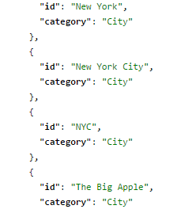
Finding all possible matches
When query is ‘New York’, all 4 terms match
Multiterm synonyms are working on initial dataset, so next step is to test on more comprehensive data

Slide 6
Testing Stemming + Synonyms on Accenture data
Indexed 891 jobs that were either software engineering specialty or finance
Created a dataset of 180 candidates from the software engineering field to match against the indexed jobs.
If software engineering candidates were matched to finance jobs, we counted this as a mismatch.
Without stemming: 29 mismatches found out of 515 matches total
With stemming: 41 mismatches found out of 1080 matches total
Stemming+Synonyms has increased number of matches overall

Slide 7
Next Steps
Continue these tests on more Accenture data: matches beyond software
Implement a working synonyms file that links the different job titles, in order to improve quality of matches

